Slide 1
How to save information in files?
Shiva K

Slide 2
Have you ever needed to jot something down to remember it later?
A list of ingredients buy for a recipe.
A guest list?
A phone number?

Slide 3
Sometimes, programs need to jot down something that they can remember it later.
Remember what page I was reading in my e-book.
Remember what treasures I have collected when I took a break from the game.

Slide 4
Working with files

Slide 5

One of the ways a program make note of something is to write to a file.

Slide 6
How do you write to a file with code?
Use the open function to open and create a file.
myFile = open(fileName,accessMode)
You must specify
- file name
- access mode

Slide 7
What is the file name?
The filename is the name of the file,including the extension of the file(eg: ,txt,.xlsx,.csv..)
This will be created in the same folder as your program is in.

Slide 8
What is the access mode?
The access mode specifies what you will do after you open a file.
You can specify of the following.
Access mode | Action
r | Read the file
w | Write to the file
a | Append to the existing file
b | Open a binary file

Slide 9
How does it look when we put it all together?
fileName = “Shiva.txt”
accessMode = “w”
myFile = open(fileName,accessMode)

Slide 10
Writing to a file!

Slide 11
Now,we have a file.How do we write to the file?
fileName = “Shiva.txt”
accessMode = “w”
myFile = open(fileName,accessMode)
myFile.write(“Hi,there?”)
myFile.write(“How are you?”)

Slide 12
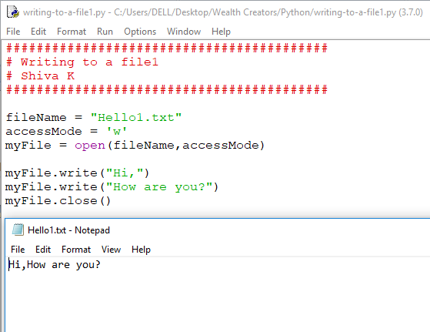

Slide 13
How can you start a new line?
Think back to the print statement.
We use the \n to go write to the next line
fileName = “Shiva.txt”
accessMode = “w”
myFile = open(fileName,accessMode)
myFile.write(“Hi,there?\n”)
myFile.write(“How are you?”)

Slide 14
When you are finished,you should always close the file.
Use the close() method.
fileName = “Shiva.txt”
accessMode = “w”
myFile = open(fileName,accessMode)
myFile.write(“Hi,there?\n”)
myFile.write(“How are you?”)
myFile.close()

Slide 15
CSV files

Slide 16
A common format for storing information in files is CSV(comma saperated values) files.
A CSV file contain date saperated by a character(mostly by a comma).
Each represents one record of data
It is also called character separated value as the character that separates the values can be anything such as semi colon.

Slide 17
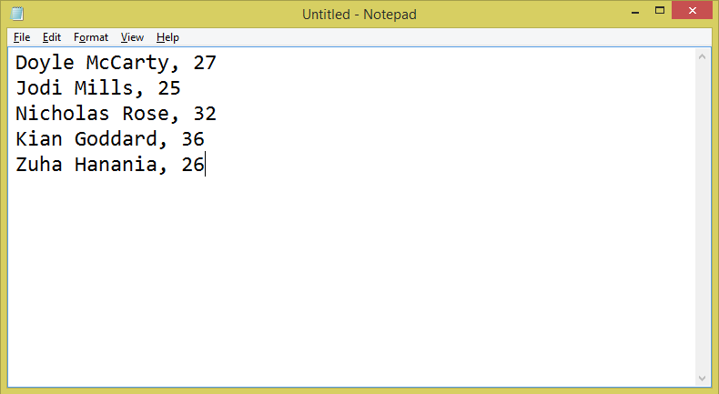

Slide 18
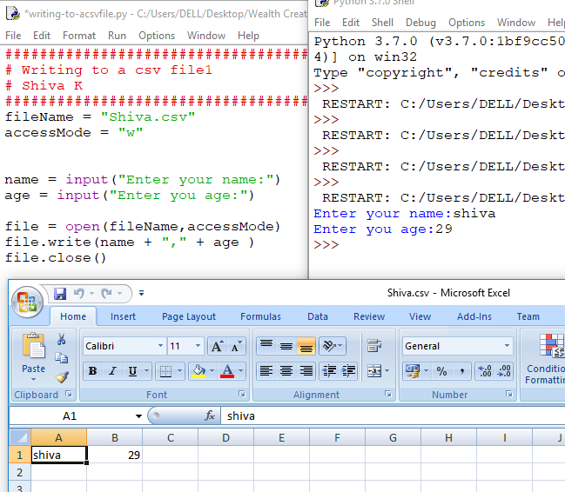

Slide 19
Your challenge!
Create the CSV file.

Slide 20
Congratulations!
Now you can write a program that can write information to a file to look it up later.

